Slide 1
Painting with Robots, Playing with Bubbles, and Introducing Mathematical Modeling –
A Virtual Potpourri of Ideas for Outreach from
My Outreach Library
Kayla K. Blyman
Saint Martin’s University
kblyman@stmartin.edu

Slide 2
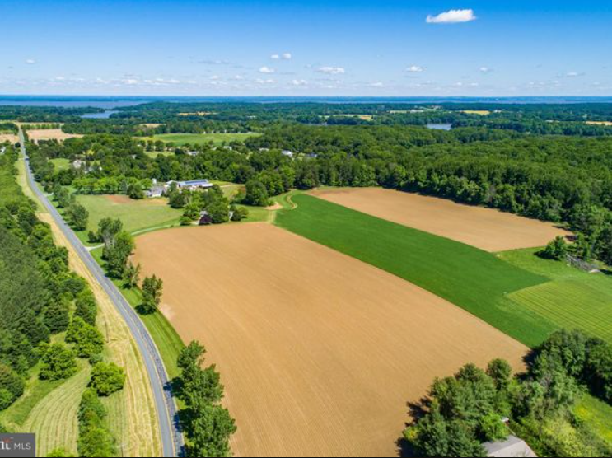
My Motivation to Outreach
I believe:
diversity matters
education matters
experience matters
mentorship matters
opportunity matters
representation matters
Future generations deserve more of this than I received. I will do my part.
Where I come from…

Slide 3
MY Motivation for the Library
Outreach became VERY time consuming.
Elementary Math Circles
Middle School Math Nights
Elementary and Middle School STEM Nights
High School Math Days (Sonia Kovalevsky and Other)
High School Med Camp
Center For Leadership and Diversity – STEM Outreach
Middle School STEM Camps
High School Math Experiences
Summer Leadership Experiences – Math Experiences
Housing and Urban Development Partnerships
I don’t want to start saying no.
There has to be a better way!
Why am I reinventing the wheel over and over and over again?

Slide 4
The Library
Logistics:
everything in one place
one copy of each file
files grouped in subfolders by activity
catalog (spreadsheet with age groups and time requirements identified with links to file locations)
Benefits:
improvement with each iteration
no need to be creative on demand
eliminates/streamlines some of the most unpleasant aspects of outreach
outreach becomes less time consuming

Slide 5
The Entries
Activity | Elementary? | Middle? | High? | College? | Minimum Time | Maximum Time
Painting with Robots | N | Y | Y | Y | 2 | 4
Playing with Bubbles | N | Y | Y | Y | 1.5 | 3
Introducing Math Modeling | Y | Y | Y | Y | 0.5 | 2
Nim | Y | Y | Y | Y | 0.5 | 2
Ramsey Theory Game | N | Y | Y | Y | 0.5 | 1.5
M&M Population Modeling | Y | Y | Y | Y | 1 | 2.5
Estimating Pi | N | Y | Y | Y | 1 | 2
Where Should You Live? | N | Y | Y | Y | 1 | 2
Each activity folder contains:
overview sheet listing supplies, the information in the catalog, and math/STEM topics covered
ready to print handouts and other necessary paper materials
separate file for each version developed for the various age-groups and times – labeled clearly
outlines flow of activities and discussions to have along the way
identifies ways to speed up or slow down along the way as need be

Slide 6
Painting with Robots
Supplies:
tech devices with the Sphero EDU App (computers, tablets, and phones all work)
Sphero robots (ideally Sphero SPRK+)
goal marking materials (painter’s tape, blocks)
measurement devices (protractors, tape measures and/or yard/meter sticks)
painting materials (tempera paint, bowls and plastic gloves, large paper, pencils)
clean-up materials (paper towels, soap & water (or wipes), towel)
tarps (if inside)
https://sphero.com/products/sphero-sprk-plus

Slide 7
Painting with Robots
Appropriate age groups:
Middle School
High School
College
Time requirements:
2 – 4 hours
Possible math and STEM connections to explore:
programming (drag and drop or JavaScript)
geometry (shapes and angles)
graph theory (existence of Euler paths and circuits)
interpolation using data (What do the unlabeled speed numbers mean?)
theory vs. practice (iterative problem solving)
friction

Slide 8
Painting with Robots
1.
2.
3.
Introducing students to Sphero robots:
Use drag and drop programming to send the robot to a line and back.
Use drag and drop programming to have the robot complete a square.
Combine the skills from 1 and 2 to send the robot to a marker, around the marker, and back.

Slide 9
Painting with Robots
4.
5a.
5c.
Painting with robots:
Draw a design and program the robot to draw it.
Put paint on the robot and run program. Repeat with different colors.
Discuss.

Slide 10
Developing Various Levels for Activities
Determining an age level:
Think about what math (and other skills) are absolutely necessary.
When do students learn those things?/When are they developmentally ready for them?
Minimum age level
Think about what math can be explored through the activity.
When do students learn those things?/When are they developmentally ready for them?
Maximum age level
Other considerations:
How long do you have to get to deeper stuff?
How engaged are the participants going to be?
What do you want the take-away to be for the participants?
What are you most excited about sharing with the participants?

Slide 11
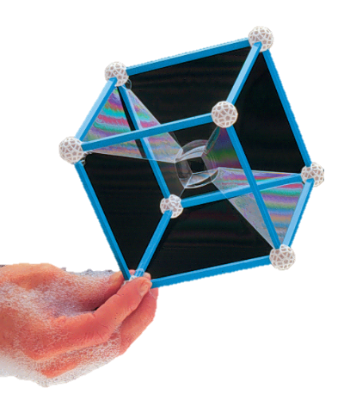
Playing with Bubbles
Supplies:
hypothesis making tools (pencils, rulers, protractors, triangle and rectangle dot template paper)
2D modeling materials (2 pieces of plexiglass, 16 round magnets)
frame making supplies (ZomeTools, or straws & masking tape)
bubble making supplies (buckets dish soap, glycerin, water)
straws (for inflating hypercube)
clean-up materials (paper towels, clean water, towels)
tarps (if inside – highly recommended outside)
https://www.zometool.com/crazy-bubbles/

Slide 12
Playing with Bubbles
Appropriate age groups:
Middle School
High School
College
Time requirements:
1.5 – 3 hours
Possible math and STEM connections to explore:
minimal spanning surfaces
geometry (shapes, angles, platonic solids)
combinatorics (counting faces, edges, and vertices)
making hypotheses (What will a minimal spanning surface look like?)
theory vs. practice (Why are they different?)
surface tension

Slide 13
Playing with Bubbles
Step 1: Minimum spanning network between 3 and 4 points
Discuss minimum spanning networks and why we care.
Have participants draw hypothesis of minimum spanning network on 3 vertices.
Use bubbles to discover minimum spanning network on 3 vertices. Discuss result and connections to nature.
Have participants draw hypothesis of minimum spanning network on 4 vertices.
Use bubbles to discover minimum spanning network on 4 vertices.
Step 2: 2D bubble wands
Have participants hypothesize what shape bubble different shape wands will make.
Participants build wands and test their hypothesis.
Discuss the behavior of bubbles. (i.e. minimum surface area, maximum volume)
Step 3: Bringing it all together – Bubbles inside 3D structures
Have participants hypothesize what will happen when a 3D structure is dipped in bubble solution.
Participants build 3D shapes and dip them in bubble solution to test their hypothesis.

Slide 14
Introducing Mathematical Modeling
Supplies:
a modeling problem
handouts or a computer and projector
Appropriate age groups:
Elementary School
Middle School
High School
College
Time requirements:
0.5 – 2 hours
Possible math and STEM connections to explore:
pretty much any applied mathematics

Slide 15
Dual Purpose Material
Keep outreach in the back of your mind.
Many classroom activities can be repackaged to be repurposed as outreach.
Playing with Bubbles evolved from an Introduction to Contemporary Mathematics lesson.
Introduction to Mathematical Modeling evolved from a Mathematical Modeling lesson.
Applications and specialized topics mentioned briefly in classes can make great outreach topics.
Ramsey Theory can be introduced to upper middle and high school students through a game.
Nim provides a gateway to introducing definitions of new operations through Nim-Sum.
Bring outreach activities into your classroom
As you engage in outreach, notice how it relates to classes you teach.
Painting with Robots provides data sets that can be used in calculus classes.
Ramsey Theory games introduce the potential for mathematical connections to zero-sum games.
Questions asked during outreach are often useful for your students to explore more deeply.

Slide 16
Developing New Entries
When inspiration strikes – Write it down!
You don’t have to have time to get all the details right to get the idea on paper.
If you aren’t a paper person, type it. Put it where you will come back to it.
It seriously takes 30 seconds.
2 minutes can be a rough outline.
When you have done this, put filling in the details on your to-do list.
You don’t have to have plans to use it to add to your library and fill in the details.
The opportunity to use it will come.
Being proactive developing activities makes implementing them less stressful.
Once the details are worked out, don’t forget to add it to your catalog!

Slide 17
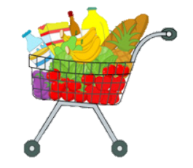
Developing New Entries
My current to-do list entry:
optimizing groceries
give recipes
give grocery possibilities with prices
given # distinct recipes must be made creating # individual meals total
have participants optimize groceries for price
have participants optimize groceries for food waste
has a game show feeling to it

Slide 18
Thank You
Questions?
Kayla K. Blyman
Saint Martin’s University
kblyman@stmartin.edu

